Slide 1
MATH2010 Probability and STATISTICS
Le DUY DUNG
College of Engineering and Computer Science

Slide 2
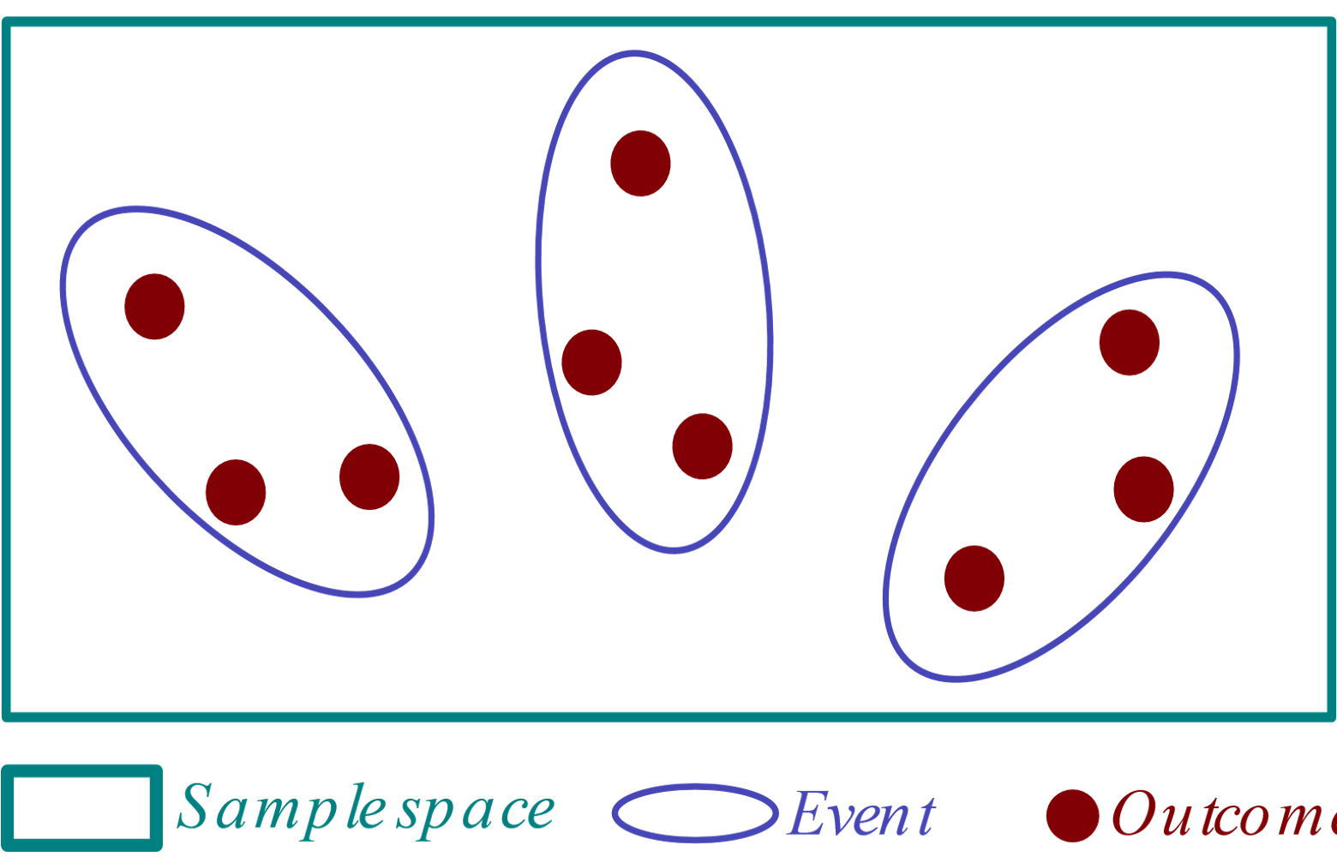
From LECTURE 2
Sample Space
Events

Slide 3
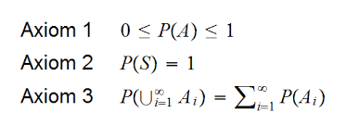
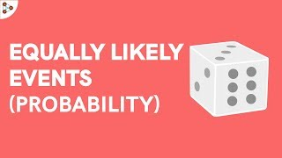
From LECTURE 2
Axioms and Corollaries of Probability
Sample Space Having Equally Likely Outcomes

Slide 4
Learning GOALS
Know the definitions of conditional probability and independence of events
Be able to compute conditional probability directly from the definition
Be able to use the multiplication rule to compute the total probability of an event
Be able to check whether two events are independent
Be able to use Bayes’ formula to ‘invert’ conditional probabilities

Slide 5

The importance of thinking Conditionally
Dr. Gregory House: “Everything is conditional, you just can't always anticipate the conditions.”
- House M.D.
Joe Blitzstein “Conditioning is the soul of statistics.”
- Harvard Professor in Statistics

Slide 6
CONDITIONAL PROBABILITY
Probability is the language for expressing our degrees of beliefs or uncertainties about events.
Observing new evidence,
Acquiring new knowsledge,
etc.
Conditional Probability addresses the fundamental question:
How could we update our beliefs in light of the evidence we observe?

Slide 7

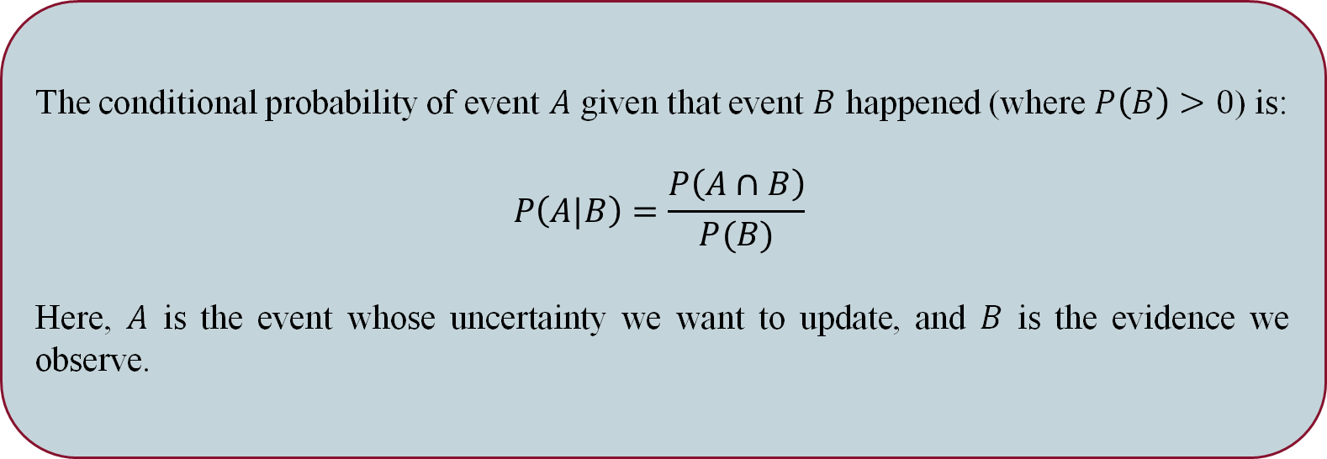

Conditional Probability
The conditional probability of event $A$ given that event $B$ happened (where $P\left(B\right)>0$) is:
$$P\left(A|B\right)=\frac{P\left(A∩B\right)}{P(B)}$$
Here, $A$ is the event whose uncertainty we want to update, and $B$ is the evidence we observe.
Note: For any event $A, P\left(A | A\right)=\frac{P(A∩A)}{P(A)}=\frac{P\left(A\right)}{P(A)}=1$
→ Upon observing that event $A$ has occurred, our updated probability for A is 1.

Slide 8
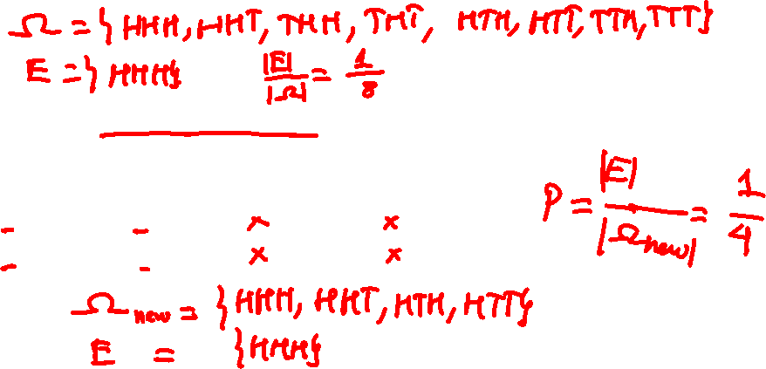
Conditional Probability
Example: Toss a fair coin three times
What is the probability of three heads?
Suppose we are told that the first toss was heads. What is the probability of three heads now?
HHH | HHT | THH | THT
HTH | HTT | TTH | TTT

Slide 9

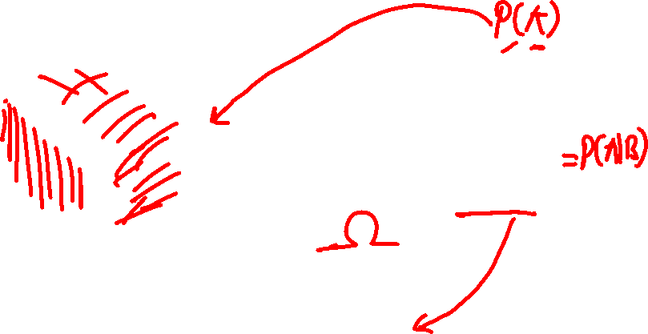

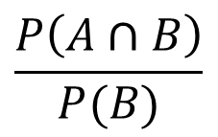

Visualizing Conditional Probability
$$A$$
$$B$$
$$\frac{P\left(A∩B\right)}{P(B)}$$
$$A∩B$$

Slide 10

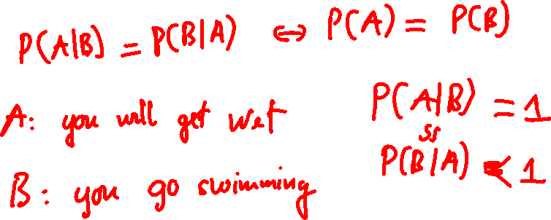
CONditional Probability (REVERSAL)
Question: Does $P\left(A | B\right)= P(B|A)$?

Slide 11
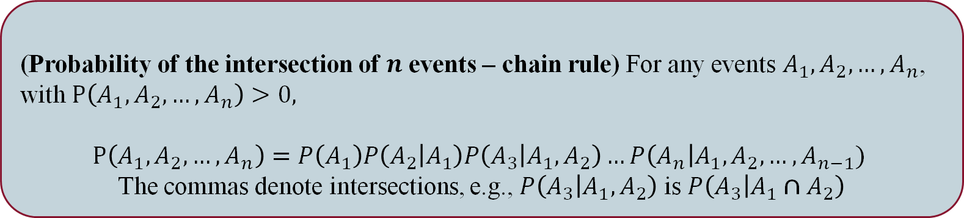
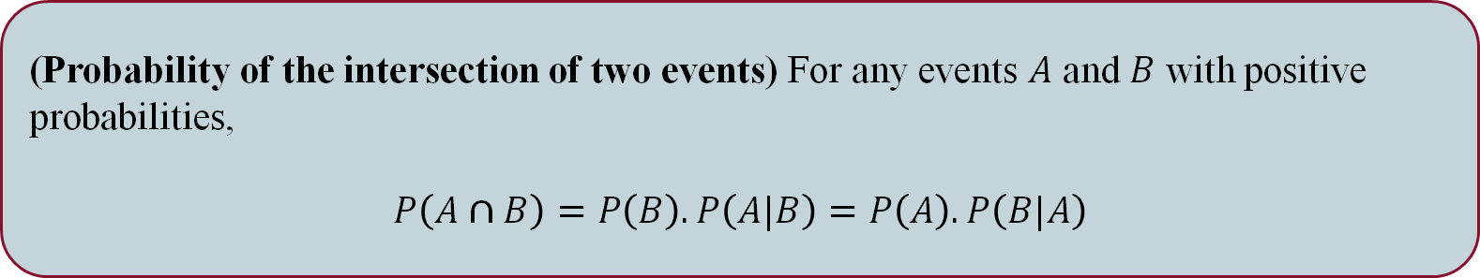
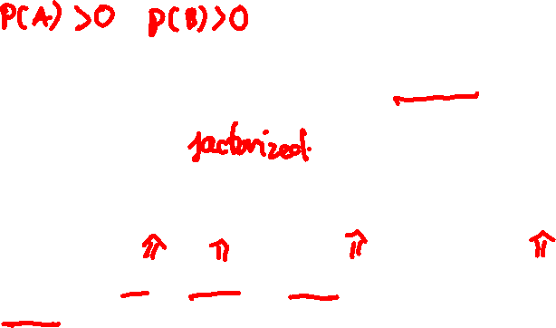
Far-reaching Consequences
(Probability of the intersection of two events) For any events $A$ and $B$ with positive probabilities,
$$P\left(A∩B\right)=P\left(B\right).P\left(A|B\right)=P\left(A\right).P\left(B|A\right)$$
(Probability of the intersection of $n$ events – chain rule) For any events $A_{1}, A_{2},…, A_{n}$, with $P\left(A_{1}, A_{2},…, A_{n}\right)>0,$
$$P\left(A_{1}, A_{2},…, A_{n}\right)=P\left(A_{1}\right)P\left(A_{2} | A_{1}\right)P\left(A_{3} | A_{1},A_{2}\right)…P\left(A_{n}\right|A_{1}, A_{2},…, A_{n−1})$$
The commas denote intersections, e.g., $P\left(A_{3} | A_{1},A_{2}\right)$ is $P\left(A_{3} | A_{1}∩A_{2}\right)$

Slide 12
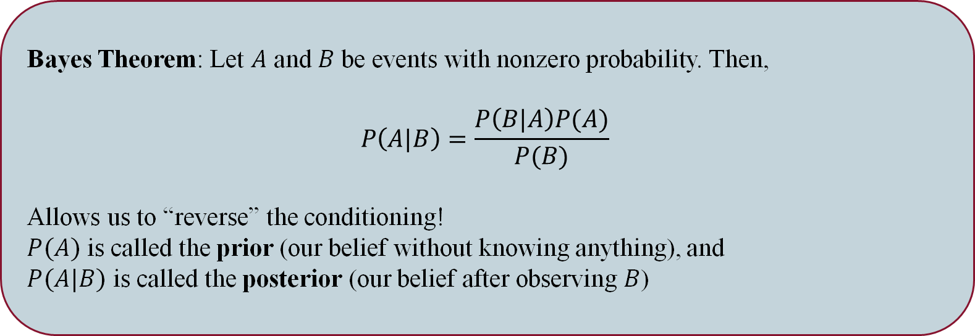

Bayes Theorem
Bayes Theorem: Let $A$ and $B$ be events with nonzero probability. Then,
$$P\left(A|B\right)=\frac{P\left(B|A\right)P(A)}{P(B)}$$
Allows us to “reverse” the conditioning!
$P(A)$ is called the prior (our belief without knowing anything), and
$P(A|B)$ is called the posterior (our belief after observing $B$)

Slide 13
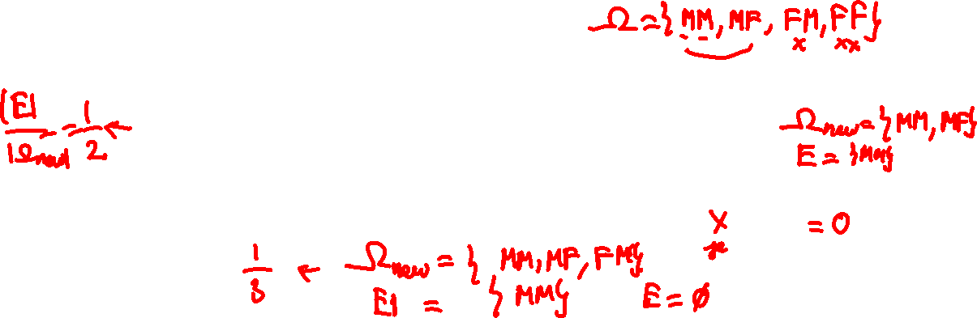
Bayes Theorem
Example: Suppose that a family has two children (whom at birth, were each equally likely to be male or female). Let’s say a telemarketer calls home and one of the two children picks up.
If the child who responded was male, and says “Let me get my older sibling”, what is the probability that both children are male?
If the child who responded was male, and says “Let me get my other sibling”, what is the probability that both children are female?

Slide 14
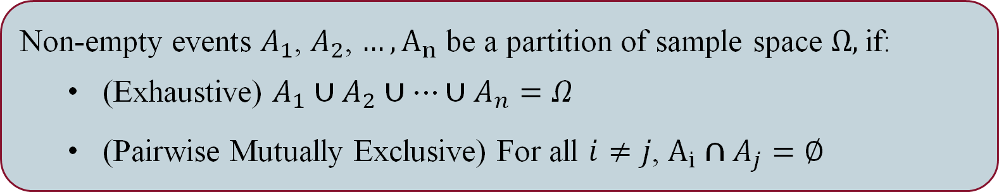
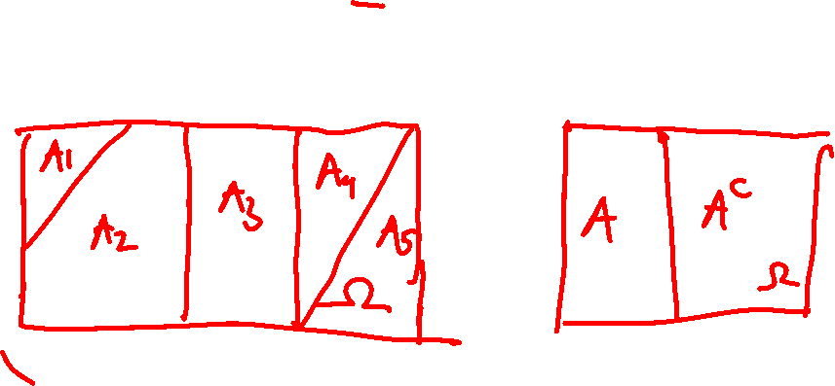
Partitioning the Sample SPace
Non-empty events $A_{1}$, $A_{2}$, $…, A_{n}$ be a partition of sample space $Ω,$if:
(Exhaustive) $A_{1}∪A_{2}∪…∪A_{n}=Ω$
(Pairwise Mutually Exclusive) For all $i≠j$, $A_{i}∩A_{j}=∅$

Slide 15
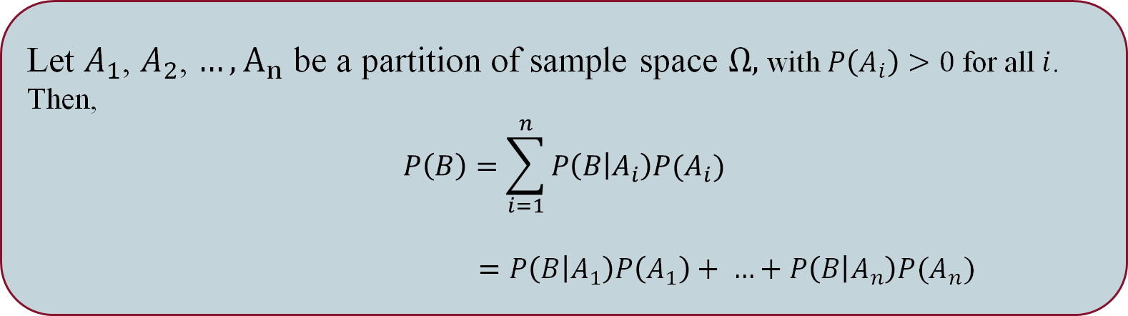
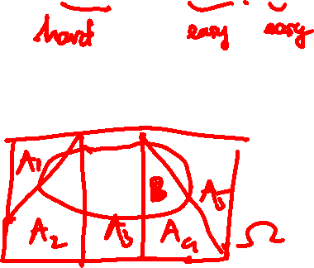
Law of total Probability (LOTP)
Let $A_{1}$, $A_{2}$, $…, A_{n}$ be a partition of sample space $Ω,$with $P\left(A_{i}\right)>0$ for all $i$.
Then,
$$P\left(B\right)=\sum_{i=1}^{n}{P\left(B | A_{i}\right)P(A_{i})}$$
$$=P\left(B | A_{1}\right)P\left(A_{1}\right)+ …+P\left(B | A_{n}\right)P(A_{n})$$

Slide 16
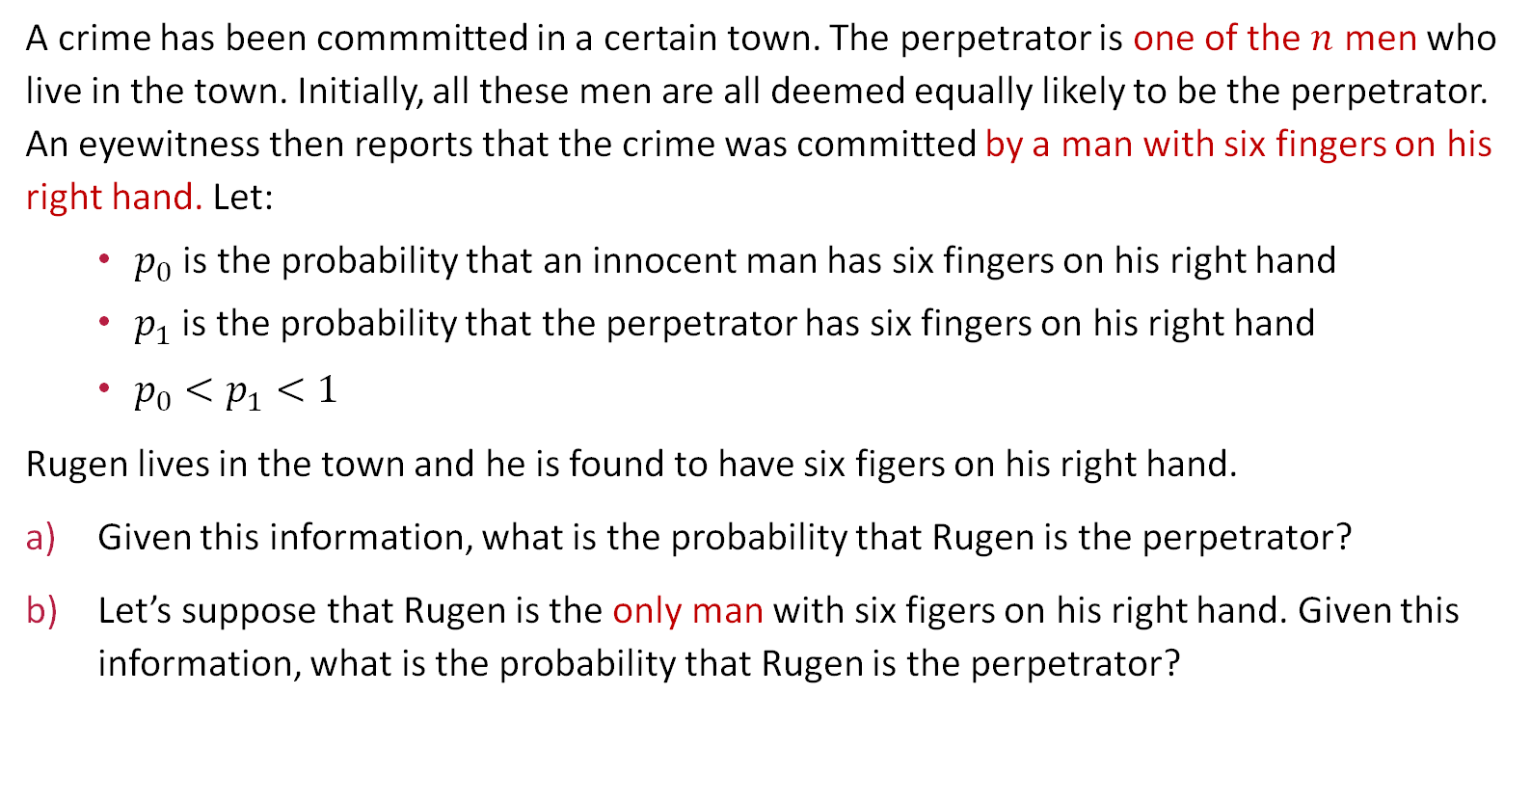
Six-Fingered man
A crime has been commmitted in a certain town. The perpetrator is one of the $n$ men who live in the town. Initially, all these men are all deemed equally likely to be the perpetrator. An eyewitness then reports that the crime was committed by a man with six fingers on his right hand. Let:
$p_{0}$ is the probability that an innocent man has six fingers on his right hand
$p_{1}$ is the probability that the perpetrator has six fingers on his right hand
$p_{0}<p_{1}<1$
Rugen lives in the town and he is found to have six figers on his right hand.
Given this information, what is the probability that Rugen is the perpetrator?
Let’s suppose that Rugen is the only man with six figers on his right hand. Given this information, what is the probability that Rugen is the perpetrator?

Slide 17

The importance of thinking Conditionally
Conditioning is extremely helpful for problem solving.
It allows us to break a problem into smaller pieces
Solve the smaller pieces separately
Combine them to solve the original problem
When using these strategies:
Try to condition on the information that, if known, would make the problem simpler
If a problem involves multiple stages, it can be helpful to condition on the first step to obtain a recursive relationship.

Slide 18
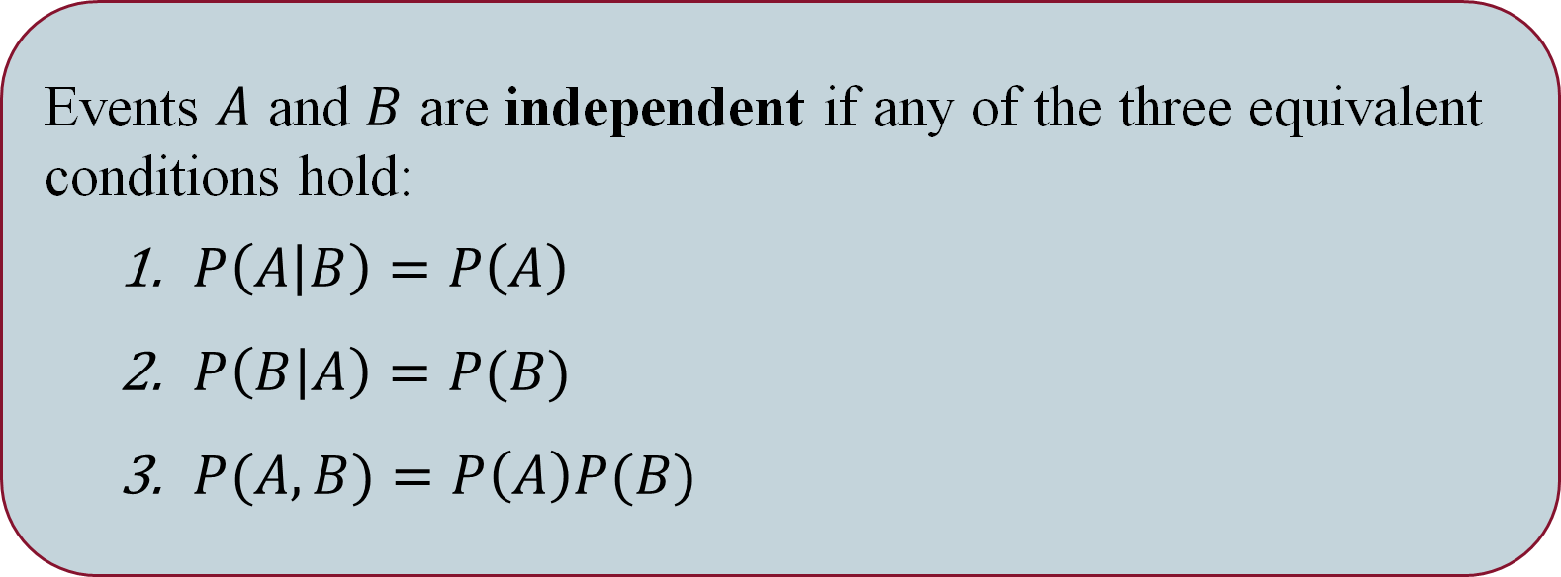
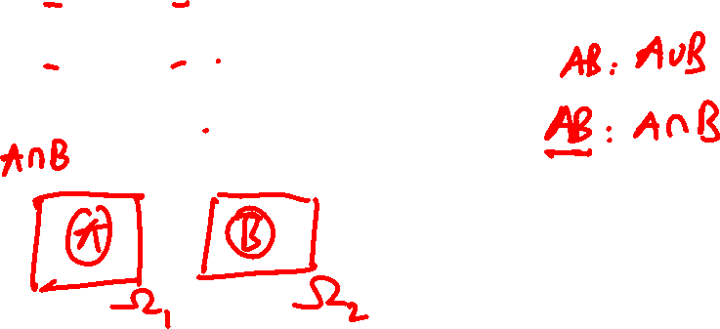
Independence
Events $A$ and $B$ are independent if any of the three equivalent conditions hold:
$P\left(A | B\right)=P\left(A\right)$
$P\left(B | A\right)=P(B)$
$P(A, B)=P\left(A\right)P(B)$

Slide 19

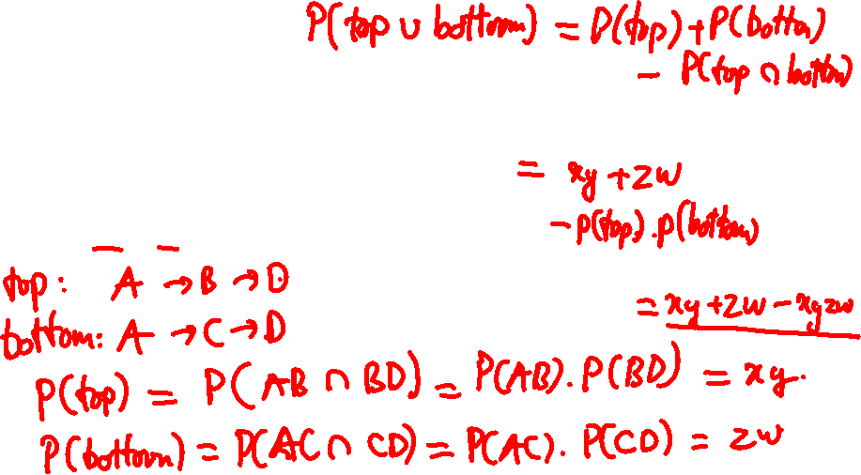



Network COmmunication
There are four stations: A, B, C, and D.
Each link works with the probability given on the
figure, independently.
What is the probability that A and D can communicate?
B
$$x$$
$$y$$
A
D
$$z$$
$$w$$
C

Slide 20
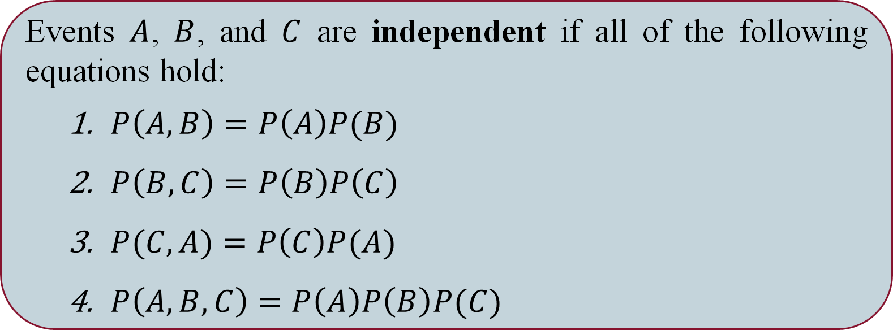
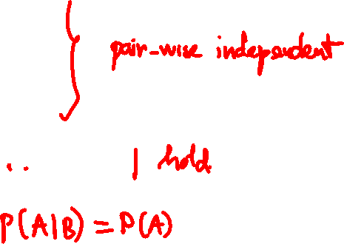
Independence of three events
Events $A$, $B$, and $C$ are independent if all of the following equations hold:
$P\left(A, B\right)=P\left(A\right)P(B)$
$P\left(B, C\right)=P\left(B\right)P\left(C\right)$
$P(C, A)=P\left(C\right)P(A)$
$P\left(A, B, C\right)=P\left(A\right)P\left(B\right)P(C)$

Slide 21
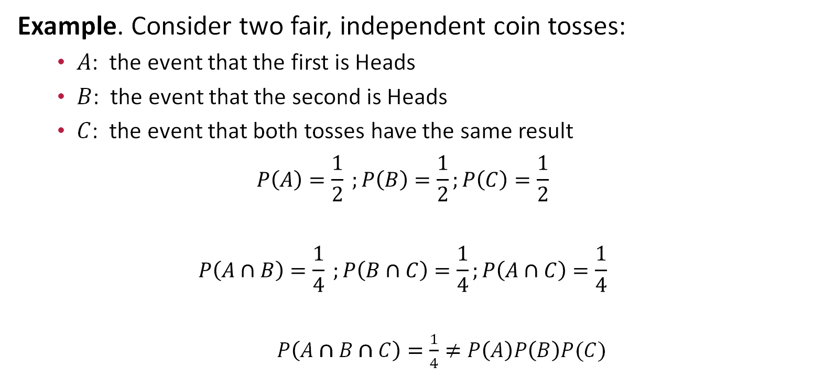
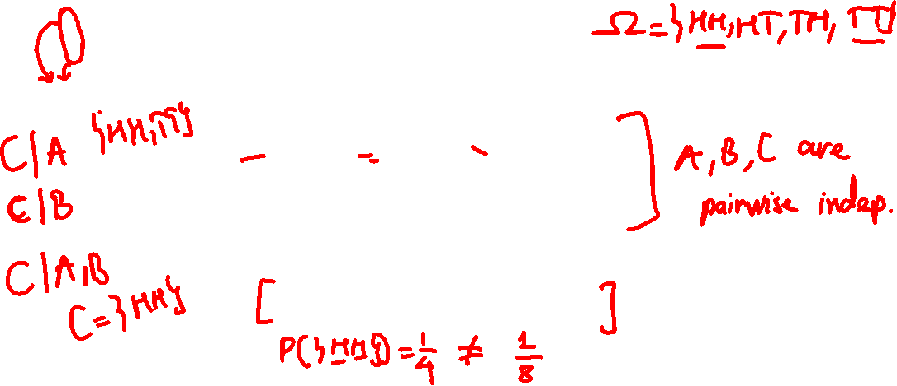
PAIRWISE Independence Does Not imply Independence
Example. Consider two fair, independent coin tosses:
$A$: the event that the first is Heads
$B$: the event that the second is Heads
$C$: the event that both tosses have the same result
$$P\left(A\right)=\frac{1}{2} ;P\left(B\right)=\frac{1}{2};P\left(C\right)=\frac{1}{2}$$
$$P\left(A∩B\right)=\frac{1}{4} ;P\left(B∩C\right)=\frac{1}{4};P\left(A∩C\right)=\frac{1}{4}$$
$P\left(A∩B∩C\right)=\frac{1}{4}≠P\left(A\right)P\left(B\right)P(C)$

Slide 22

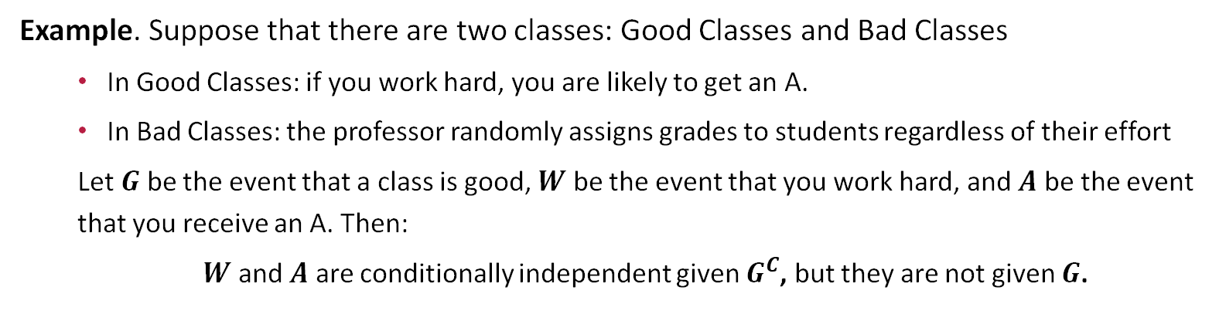

Conditional Independence
Events $A$ and $B$ are conditionally independent given an event $C$
$$P(A, B|C)=P\left(A|C\right)P(B|C)$$
Example. Suppose that there are two classes: Good Classes and Bad Classes
In Good Classes: if you work hard, you are likely to get an A.
In Bad Classes: the professor randomly assigns grades to students regardless of their effort
Let $G$ be the event that a class is good, $W$ be the event that you work hard, and $A$ be the event that you receive an A. Then:
$W$ and $A$ are conditionally independent given $G^{C}$, but they are not given $G$.

Slide 23
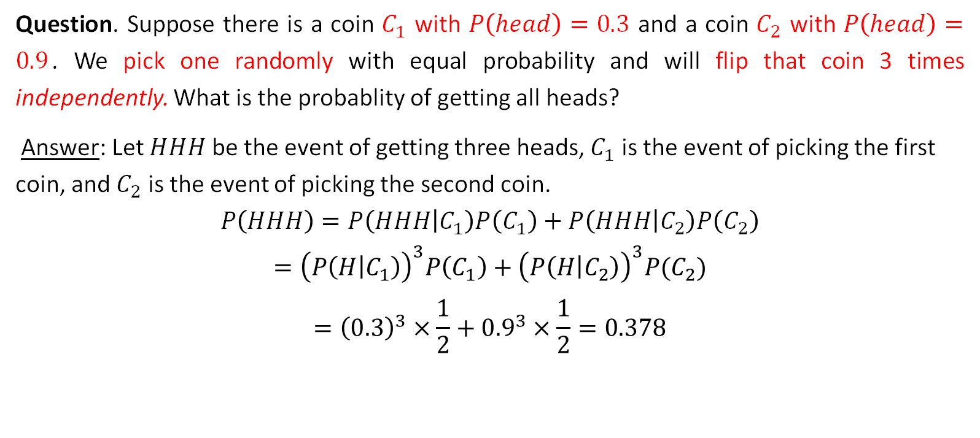
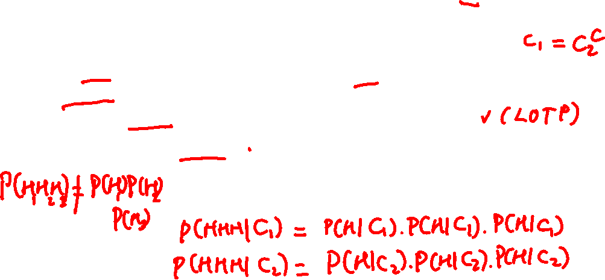
Conditional Independence
Question. Suppose there is a coin $C_{1}$ with $P\left(head\right)=0.3$ and a coin $C_{2}$ with $P\left(head\right)=0.9$. We pick one randomly with equal probability and will flip that coin 3 times independently. What is the probablity of getting all heads?
Answer: Let $HHH$ be the event of getting three heads, $C_{1}$ is the event of picking the first coin, and $C_{2}$ is the event of picking the second coin.
$$P\left(HHH\right)=P\left(HHH | C_{1}\right)P\left(C_{1}\right)+P\left(HHH | C_{2}\right)P\left(C_{2}\right)$$
$$={\left(P\left(H | C_{1}\right)\right)}^{3}P\left(C_{1}\right)+{\left(P\left(H | C_{2}\right)\right)}^{3}P(C_{2})$$
$$={\left(0.3\right)}^{3}×\frac{1}{2}+{0.9}^{3}×\frac{1}{2}=0.378$$

Slide 24
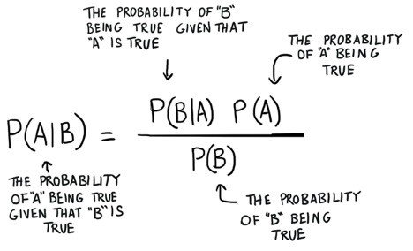
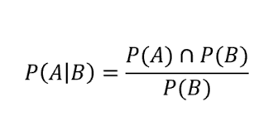

WHAT WE Have Learnt
Bayes Theorem
Conditional Probability

Slide 25
One more thing …

Slide 26


Slide 27
CA1 Counting, Sets, and Probability Basics
ACCESS CODE:
Counting4Fun!

Slide 28
